Slide 1
The 8085 Microprocessor Architecture

Slide 2
Processor Generations
Processor Address Bus Data Bus Clock Speed 4004 10 4 108KHz 8008 14 8 200KHz 8080 16 8 2MHz 8085 16 8 5MHz 8086 20 16 5MHz 8088 20 8 5MHz 80286 24 16 8MHz 80386 32 32 16MHz 80486 32 32 25MHz Pentium 32 32/64 60MHz Pentium Pro 36 32/64 150MHz Pentium II 36 64 233MHz Pentium III 36 64 650MHz Pentium 4 36 64 1.4GHz
Institute of Engineering & Management, Ashram Campus

Slide 3
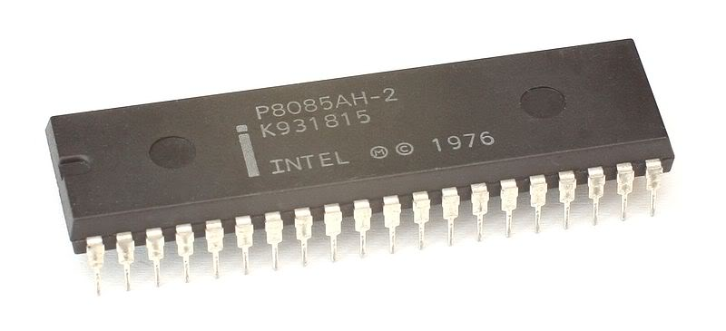
Intel 8085
Institute of Engineering & Management, Ashram Campus

Slide 4
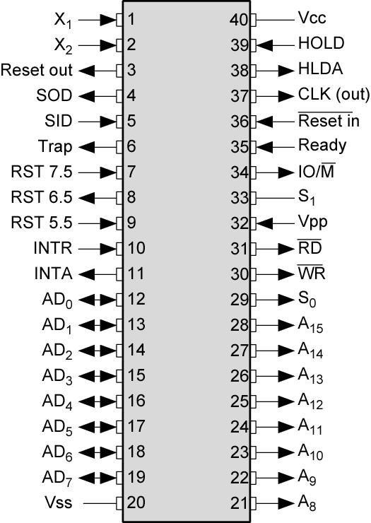
Intel 8085 Pin Configuration
Institute of Engineering & Management, Ashram Campus

Slide 5
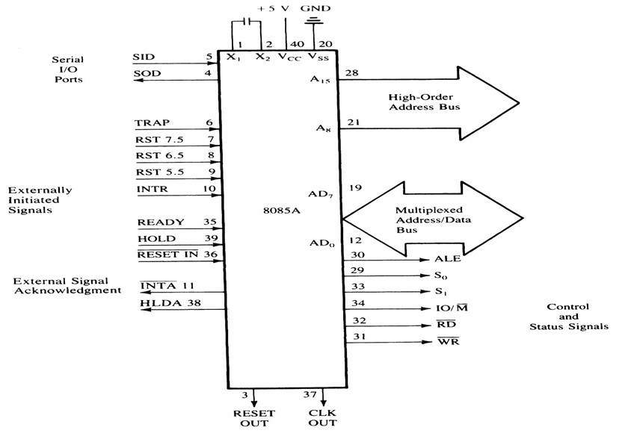
Signals and I/O Pins
Institute of Engineering & Management, Ashram Campus

Slide 6
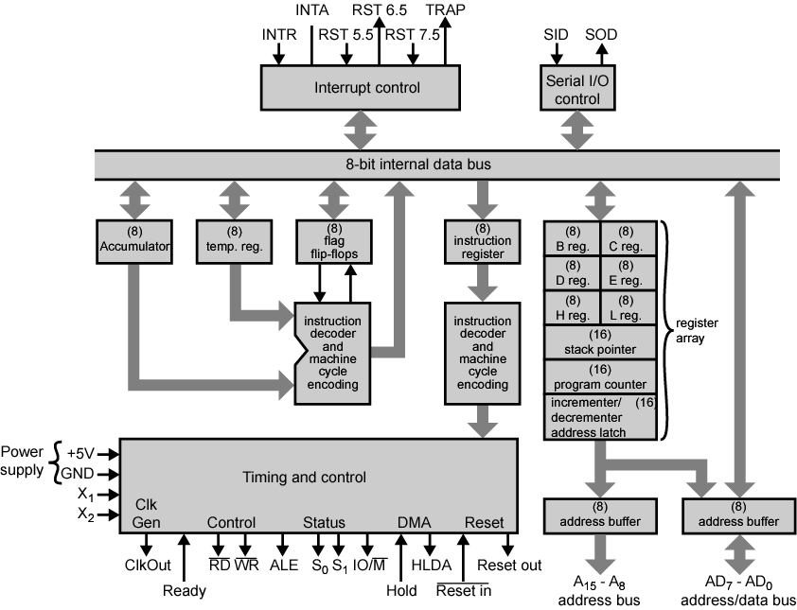
Internal Architecture
Institute of Engineering & Management, Ashram Campus

Slide 7
Processor System Architecture
The typical processor system consists of:
CPU (central processing unit)
ALU (arithmetic-logic unit)
Control Logic
Registers, etc…
Memory
Input / Output interfaces
Interconnections between these units:
Address Bus
Data Bus
Control Bus
Institute of Engineering & Management, Ashram Campus

Slide 8
The 8085: CPU Internal Structure
The internal architecture of the 8085 CPU is capable of performing the following operations:
Store 8-bit data (Registers, Accumulator)
Perform arithmetic and logic operations (ALU)
Test for conditions (IF / THEN)
Sequence the execution of instructions
Store temporary data in RAM during execution
Institute of Engineering & Management, Ashram Campus

Slide 9
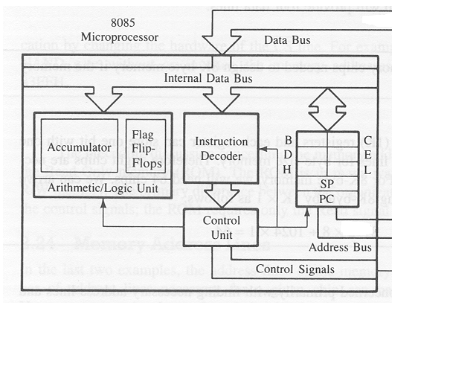
The 8085: CPU Internal Structure
Institute of Engineering & Management, Ashram Campus

Slide 10
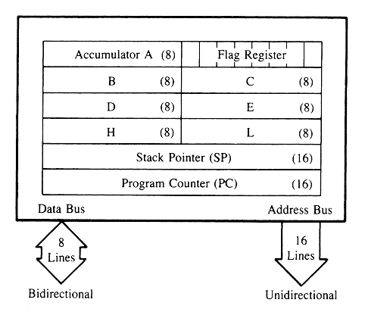
The 8085: Registers
Institute of Engineering & Management, Ashram Campus

Slide 11
The 8085: CPU Internal Structure
Registers
Six general purpose 8-bit registers: B, C, D, E, H, L
They can also be combined as register pairs to
perform 16-bit operations: BC, DE, HL
Registers are programmable (data load, move, etc.)
Accumulator
Single 8-bit register that is part of the ALU !
Used for arithmetic / logic operations – the result is always stored in the accumulator.
Institute of Engineering & Management, Ashram Campus

Slide 12
The 8085: CPU Internal Structure
The Program Counter (PC)
This is a register that is used to control the sequencing of the execution of instructions.
This register always holds the address of the next instruction.
Since it holds an address, it must be 16 bits wide.
The Stack pointer
The stack pointer is also a 16-bit register that is used to point into memory.
The memory this register points to is a special area called the stack.
The stack is an area of memory used to hold data that will be retreived soon.
The stack is usually accessed in a Last In First Out (LIFO) fashion.
Institute of Engineering & Management, Ashram Campus

Slide 13
The 8085 and Its Busses
The 8085 is an 8-bit general purpose microprocessor that can address 64K Byte of memory.
It has 40 pins and uses +5V for power. It can run at a maximum frequency of 3 MHz.
The pins on the chip can be grouped into 6 groups:
Address Bus.
Data Bus.
Control and Status Signals.
Power supply and frequency.
Externally Initiated Signals.
Serial I/O ports.
Institute of Engineering & Management, Ashram Campus

Slide 14
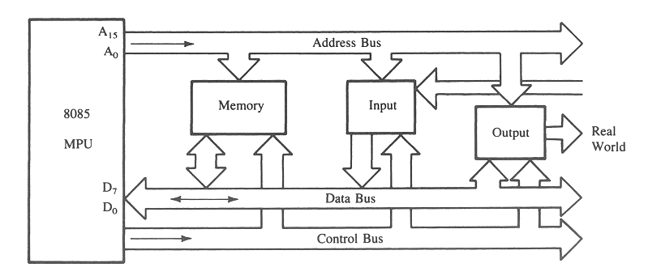
The 8085 Bus Structure
The 8-bit 8085 CPU (or MPU – Micro Processing Unit) communicates with the other units using a 16-bit address bus, an 8-bit data bus and a control bus.
Institute of Engineering & Management, Ashram Campus

Slide 15
The Address and Data Busses
The address bus has 8 signal lines A8 – A15 which are unidirectional.
The other 8 address bits are multiplexed (time shared) with the 8 data bits.
So, the bits AD0 – AD7 are bi-directional and serve as A0 – A7 and D0 – D7 at the same time.
During the execution of the instruction, these lines carry the address bits during the early part, then during the late parts of the execution, they carry the 8 data bits.
In order to separate the address from the data, we can use a latch to save the value before the function of the bits changes.
Institute of Engineering & Management, Ashram Campus

Slide 16
The Control and Status Signals
There are 4 main control and status signals. These are:
ALE: Address Latch Enable. This signal is a pulse that become 1 when the AD0 – AD7 lines have an address on them. It becomes 0 after that. This signal can be used to enable a latch to save the address bits from the AD lines.
RD: Read. Active low.
WR: Write. Active low.
IO/M: This signal specifies whether the operation is a memory operation (IO/M=0) or an I/O operation (IO/M=1).
S1 and S0 : Status signals to specify the kind of operation being performed .Usually un-used in small systems.
Institute of Engineering & Management, Ashram Campus

Slide 17
Frequency Control Signals
There are 3 important pins in the frequency control group.
X0 and X1 are the inputs from the crystal or clock generating circuit.
The frequency is internally divided by 2.
So, to run the microprocessor at 3 MHz, a clock running at 6 MHz should be connected to the X0 and X1 pins.
CLK (OUT): An output clock pin to drive the clock of the rest of the system.
We will discuss the rest of the control signals as we get to them.
Institute of Engineering & Management, Ashram Campus

Slide 18
Microprocessor Communication and Bus Timing
To understand how the microprocessor operates and uses these different signals, we should study the process of communication between the microprocessor and memory during a memory read or write operation.
Lets look at timing and the data flow of an instruction fetch operation. (Example 3.1)
Institute of Engineering & Management, Ashram Campus

Slide 19
Steps For Fetching an Instruction
Lets assume that we are trying to fetch the instruction at memory location 2005. That means that the program counter is now set to that value.
The following is the sequence of operations:
The program counter places the address value on the address bus and the controller issues a RD signal.
The memory’s address decoder gets the value and determines which memory location is being accessed.
The value in the memory location is placed on the data bus.
The value on the data bus is read into the instruction decoder inside the microprocessor.
After decoding the instruction, the control unit issues the proper control signals to perform the operation.
Institute of Engineering & Management, Ashram Campus

Slide 20
Timing Signals For Fetching an Instruction
Now, lets look at the exact timing of this sequence of events as that is extremely important. (figure 3.3)
At T1 , the high order 8 address bits (20H) are placed on the address lines A8 – A15 and the low order bits are placed on AD7–AD0. The ALE signal goes high to indicate that AD0 – AD8 are carrying an address. At exactly the same time, the IO/M signal goes low to indicate a memory operation.
At the beginning of the T2 cycle, the low order 8 address bits are removed from AD7– AD0 and the controller sends the Read (RD) signal to the memory. The signal remains low (active) for two clock periods to allow for slow devices. During T2 , memory places the data from the memory location on the lines AD7– AD0 .
During T3 the RD signal is Disabled (goes high). This turns off the output Tri-state buffers in the memory. That makes the AD7– AD0 lines go to high impedence mode.
Institute of Engineering & Management, Ashram Campus

Slide 21
Demultiplexing AD7-AD0
From the above description, it becomes obvious that the AD7– AD0 lines are serving a dual purpose and that they need to be demultiplexed to get all the information.
The high order bits of the address remain on the bus for three clock periods. However, the low order bits remain for only one clock period and they would be lost if they are not saved externally. Also, notice that the low order bits of the address disappear when they are needed most.
To make sure we have the entire address for the full three clock cycles, we will use an external latch to save the value of AD7– AD0 when it is carrying the address bits. We use the ALE signal to enable this latch.
Institute of Engineering & Management, Ashram Campus

Slide 22
Demultiplexing AD7-AD0
8085
A15-A8
ALE
AD7-AD0
Latch
A7- A0
D7- D0
Given that ALE operates as a pulse during T1, we will be able to latch the address. Then when ALE goes low, the address is saved and the AD7– AD0 lines can be used for their purpose as the bi-directional data lines.
Institute of Engineering & Management, Ashram Campus

Slide 23
Cycles and States
From the above discussion, we can define terms that will become handy later on:
T- State: One subdivision of an operation. A T-state lasts for one clock period.
An instruction’s execution length is usually measured in a number of T-states. (clock cycles).
Machine Cycle: The time required to complete one operation of accessing memory, I/O, or acknowledging an external request.
This cycle may consist of 3 to 6 T-states.
Instruction Cycle: The time required to complete the execution of an instruction.
In the 8085, an instruction cycle may consist of 1 to 6 machine cycles.
Institute of Engineering & Management, Ashram Campus

Slide 24
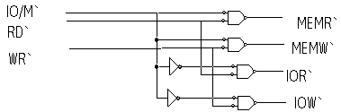
Generating Control Signals
The 8085 generates a single RD signal. However, the signal needs to be used with both memory and I/O. So, it must be combined with the IO/M signal to generate different control signals for the memory and I/O.
Keeping in mind the operation of the IO/M signal we can use the following circuitry to generate the right set of signals:
Institute of Engineering & Management, Ashram Campus

Slide 25
A closer look at the 8085 Architecture
Previously we discussed the 8085 from a programmer’s perspective.
Now, lets look at some of its features with more detail.
Institute of Engineering & Management, Ashram Campus

Slide 26
The ALU
In addition to the arithmetic & logic circuits, the ALU includes the accumulator, which is part of every arithmetic & logic operation.
Also, the ALU includes a temporary register used for holding data temporarily during the execution of the operation. This temporary register is not accessible by the programmer.
Institute of Engineering & Management, Ashram Campus

Slide 27
The Flags register
There is also the flags register whose bits are affected by the arithmetic & logic operations.
S-sign flag
The sign flag is set if bit D7 of the accumulator is set after an arithmetic or logic operation.
Z-zero flag
Set if the result of the ALU operation is 0. Otherwise is reset. This flag is affected by operations on the accumulator as well as other registers. (DCR B).
AC-Auxiliary Carry
This flag is set when a carry is generated from bit D3 and passed to D4 . This flag is used only internally for BCD operations. (Section 10.5 describes BCD addition including the DAA instruction).
P-Parity flag
After an ALU operation if the result has an even # of 1’s the p-flag is set. Otherwise it is cleared. So, the flag can be used to indicate even parity.
CY-carry flag
Discussed earlier
Institute of Engineering & Management, Ashram Campus

Slide 28
More on the 8085 machine cycles
The 8085 executes several types of instructions with each requiring a different number of operations of different types. However, the operations can be grouped into a small set.
The three main types are:
Memory Read and Write.
I/O Read and Write.
Request Acknowledge.
These can be further divided into various operations (machine cycles).
Institute of Engineering & Management, Ashram Campus

Slide 29
Opcode Fetch Machine Cycle
The first step of executing any instruction is the Opcode fetch cycle.
In this cycle, the microprocessor brings in the instruction’s Opcode from memory.
To differentiate this machine cycle from the very similar “memory read” cycle, the control & status signals are set as follows:
IO/M=0, s0 and s1 are both 1.
This machine cycle has four T-states.
The 8085 uses the first 3 T-states to fetch the opcode.
T4 is used to decode and execute it.
It is also possible for an instruction to have 6 T-states in an opcode fetch machine cycle.
Institute of Engineering & Management, Ashram Campus

Slide 30
Memory Read Machine Cycle
The memory read machine cycle is exactly the same as the opcode fetch except:
It only has 3 T-states
The s0 signal is set to 0 instead.
Institute of Engineering & Management, Ashram Campus

Slide 31
The Memory Read Machine Cycle
To understand the memory read machine cycle, let’s study the execution of the following instruction:
MVI A, 32
In memory, this instruction looks like:
The first byte 3EH represents the opcode for loading a byte into the accumulator (MVI A), the second byte is the data to be loaded.
The 8085 needs to read these two bytes from memory before it can execute the instruction. Therefore, it will need at least two machine cycles.
The first machine cycle is the opcode fetch discussed earlier.
The second machine cycle is the Memory Read Cycle.
Figure 3.10 page 83.
2000H
3E
2001H
32
Institute of Engineering & Management, Ashram Campus

Slide 32
Machine Cycles vs. Number of bytes in the instruction
Machine cycles and instruction length, do not have a direct relationship.
To illustrate lets look at the machine cycles needed to execute the following instruction.
STA 2065H
This is a 3-byte instruction requiring 4 machine cycles and 13 T-states.
The machine code will be stored in memory as shown to the right
This instruction requires the following 4 machine cycles:
Opcode fetch to fetch the opcode (32H) from location 2010H, decode it and determine that 2 more bytes are needed (4 T-states).
Memory read to read the low order byte of the address (65H) (3 T-states).
Memory read to read the high order byte of the address (20H) (3 T-states).
A memory write to write the contents of the accumulator into the memory location.
32H
2010H
65H
2011H
20H
2012H
Institute of Engineering & Management, Ashram Campus

Slide 33
The Memory Write Operation
In a memory write operation:
The 8085 places the address (2065H) on the address bus
Identifies the operation as a memory write (IO/M=0, s1=0, s0=1).
Places the contents of the accumulator on the data bus and asserts the signal WR.
During the last T-state, the contents of the data bus are saved into the memory location.
Institute of Engineering & Management, Ashram Campus

Slide 34
Memory interfacing
There needs to be a lot of interaction between the microprocessor and the memory for the exchange of information during program execution.
Memory has its requirements on control signals and their timing.
The microprocessor has its requirements as well.
The interfacing operation is simply the matching of these requirements.
Institute of Engineering & Management, Ashram Campus

Slide 35
Memory structure & its requirements
RAM
Data Lines
ROM
Input Buffer
WR
Address
Lines
CS
Address
Lines
CS
Output Buffer
RD
Output Buffer
RD
Data Lines
Date
Lines
The process of interfacing the above two chips is the same.
However, the ROM does not have a WR signal.
Institute of Engineering & Management, Ashram Campus

Slide 36
Interfacing Memory
Accessing memory can be summarized into the following three steps:
Select the chip.
Identify the memory register.
Enable the appropriate buffer.
Translating this to microprocessor domain:
The microprocessor places a 16-bit address on the address bus.
Part of the address bus will select the chip and the other part will go through the address decoder to select the register.
The signals IO/M and RD combined indicate that a memory read operation is in progress. The MEMR signal can be used to enable the RD line on the memory chip.
Institute of Engineering & Management, Ashram Campus

Slide 37
Address decoding
The result of address decoding is the identification of a register for a given address.
A large part of the address bus is usually connected directly to the address inputs of the memory chip.
This portion is decoded internally within the chip.
What concerns us is the other part that must be decoded externally to select the chip.
This can be done either using logic gates or a decoder.
Institute of Engineering & Management, Ashram Campus

Slide 38

The Overall Picture
Putting all of the concepts together, we get:
A15- A10
Chip Selection
Circuit
8085
A15-A8
CS
ALE
AD7-AD0
A9- A0
1K Byte
Memory
Chip
Latch
A7- A0
WR
RD
IO/M
D7- D0
RD
WR
Institute of Engineering & Management, Ashram Campus

Slide 39
8085 Instruction Set
Data transfer operations
Between registers
Between memory location and a register
Direct write to a register / memory
Between I/O device and accumulator
Arithmetic operations (ADD, SUB, INR, DCR)
Logic operations
Branching operations (JMP, CALL, RET)
Institute of Engineering & Management, Ashram Campus

Slide 40
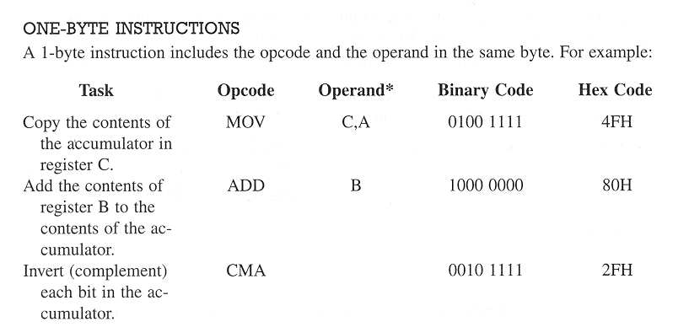
8085 Instruction Types
Institute of Engineering & Management, Ashram Campus

Slide 41
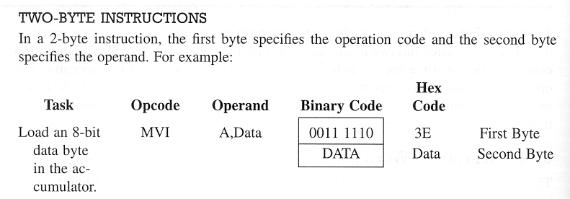
8085 Instruction Types
Institute of Engineering & Management, Ashram Campus

Slide 42
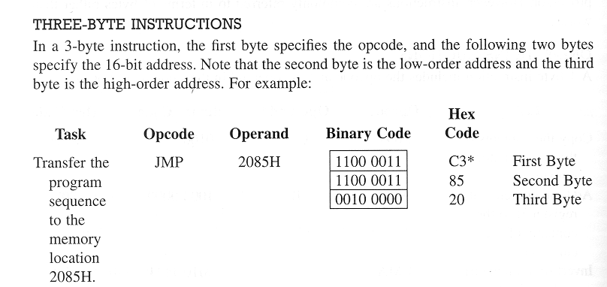
8085 Instruction Types
Institute of Engineering & Management, Ashram Campus

Slide 43
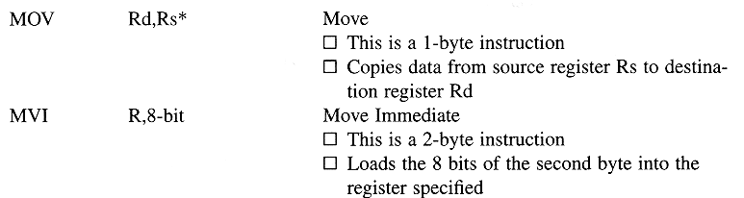
Simple Data Transfer Operations
Examples:
MOV B,A 47 From ACC to REG
MOV C,D 4A Between two REGs
MVI D,47 16 Direct-write into REGD 47
Institute of Engineering & Management, Ashram Campus

Slide 44
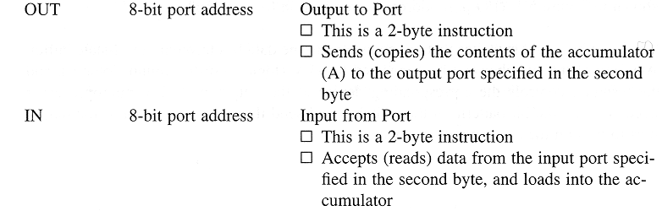
Simple Data Transfer Operations
Example:
OUT 05 D3
05
Contents of ACC sent to output port number 05.
Institute of Engineering & Management, Ashram Campus

Slide 45
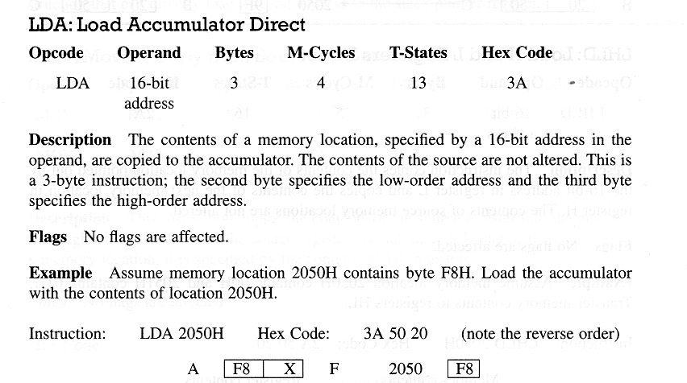
Simple Memory Access Operations
Institute of Engineering & Management, Ashram Campus

Slide 46
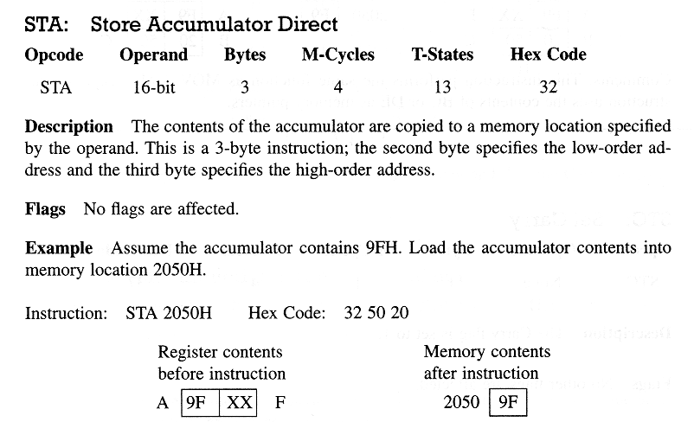
Simple Memory Access Operations
Institute of Engineering & Management, Ashram Campus

Slide 47
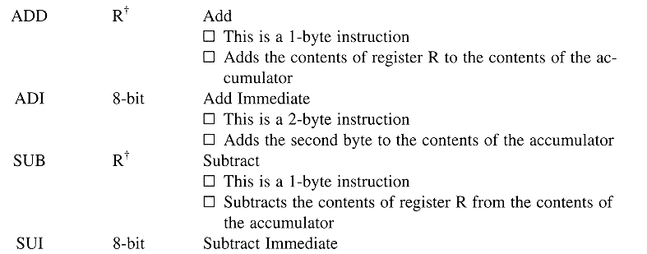
Arithmetic Operations
Institute of Engineering & Management, Ashram Campus

Slide 48
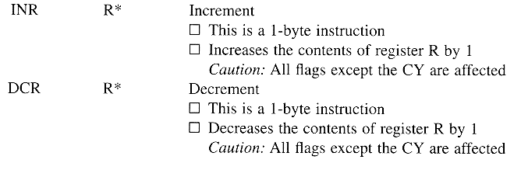
Arithmetic Operations
Institute of Engineering & Management, Ashram Campus

Slide 49
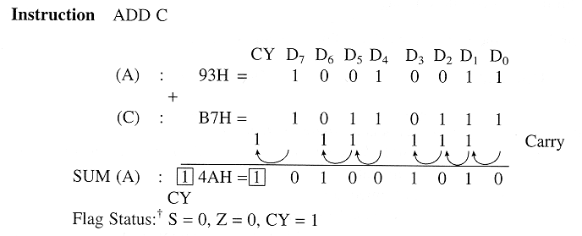
Arithmetic Operations
Institute of Engineering & Management, Ashram Campus

Slide 50
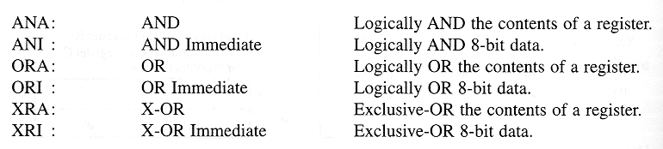
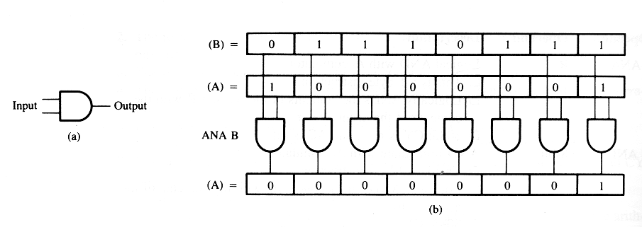
Overview of Logic Operations
Institute of Engineering & Management, Ashram Campus

Slide 51
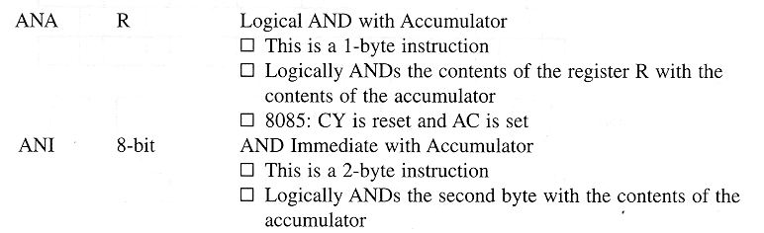
Logic Operations
Institute of Engineering & Management, Ashram Campus

Slide 52
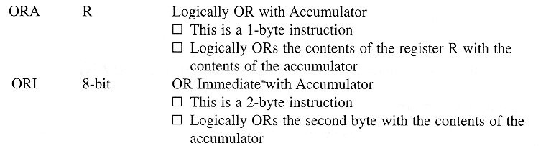
Logic Operations
Institute of Engineering & Management, Ashram Campus

Slide 53
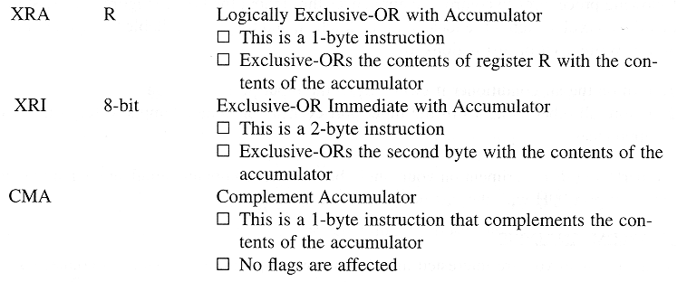
Logic Operations
Institute of Engineering & Management, Ashram Campus

Slide 54
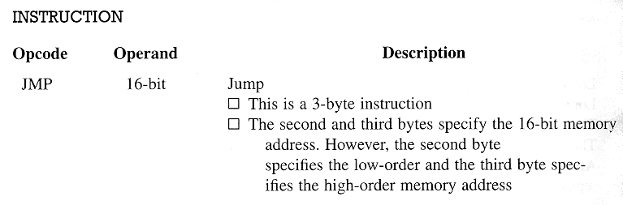
Branching Operations
Note: This is an unconditional jump operation.
It will always force the program counter to a fixed
memory address continuous loop !
Institute of Engineering & Management, Ashram Campus

Slide 55
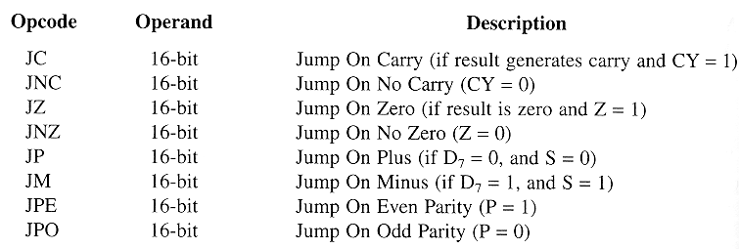
Branching Operations
Conditional jump operations are very useful for decision making during the execution of the program.
Institute of Engineering & Management, Ashram Campus

Slide 56
Direct Memory Access Operations
Institute of Engineering & Management, Ashram Campus

Slide 57
Direct Memory Access Operations
Institute of Engineering & Management, Ashram Campus

Slide 58
Indirect Memory Access Operations
Use a register PAIR as an address pointer !
We can define memory access operations using the memory location (16 bit address) stored in a register pair: BC, DE or HL.
First, we have be able to load the register pairs.
LXI B, (16-bit address)
LXI D, (16-bit address)
LXI H, (16-bit address)
We can also increment / decrement register pairs.
Institute of Engineering & Management, Ashram Campus

Slide 59
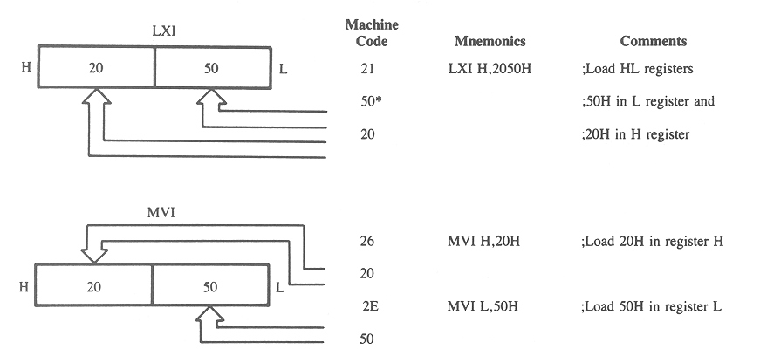
Loading Register Pairs
Institute of Engineering & Management, Ashram Campus

Slide 60
Interrupts in 8085
In many real-time operations, the microprocessor should be able to receive an external asynchronous signal (interrupt) while it is running a routine.
When the interrupt signal arrives:
The processor will break its routine
Go to a different routine (service routine)
Complete the service routine
Go back to the “regular” routine
Institute of Engineering & Management, Ashram Campus

Slide 61
Interrupts in 8085
In order to execute an interrupt routine, the processor:
Should be able to accept interrupts (interrupt enable)
Save the last content of the program counter (PC)
Know where to go in program memory to execute
the service routine
Tell the outside world that it is executing an interrupt
Go back to the saved PC location when finished.
Institute of Engineering & Management, Ashram Campus

Slide 62
Vectored Interrupts
There are four other interrupt inputs in 8085 that
transfer the operation immediately to a specific address:
TRAP: go to 0024
RST 7.5: go to 003C
RST 6.5 0034
RST 5.5 002C
RST 7.5, RST 6.5 and RST 5.5 are maskable interrupts, they are acknowledged only if they are not masked !
Institute of Engineering & Management, Ashram Campus

Slide 63
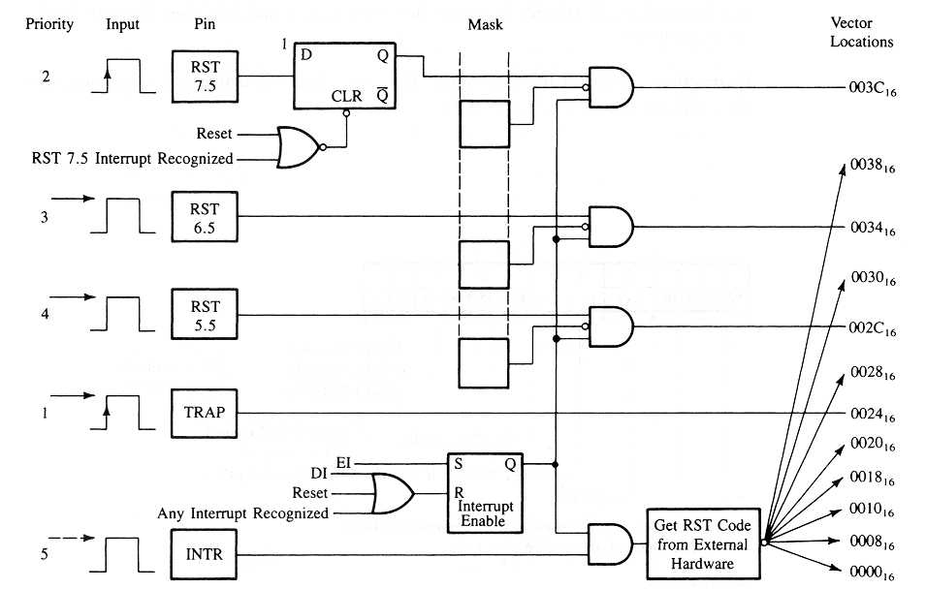
Vectored Interrupts
Institute of Engineering & Management, Ashram Campus

Slide 64
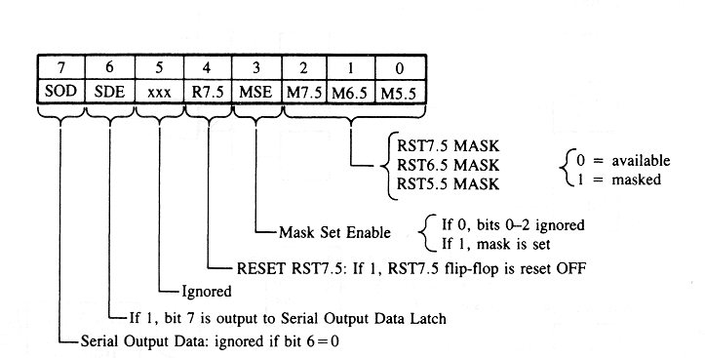
SIM: Set Interrupt Mask
Institute of Engineering & Management, Ashram Campus

